Slide 1
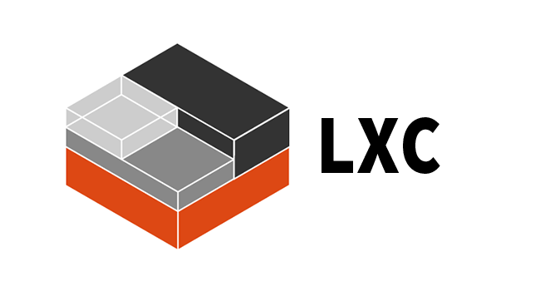
Introduction to Containers and Docker

Slide 2
Agenda
Why containers?
Docker containers
Conclusion

Slide 3
Why Containers?

Slide 4
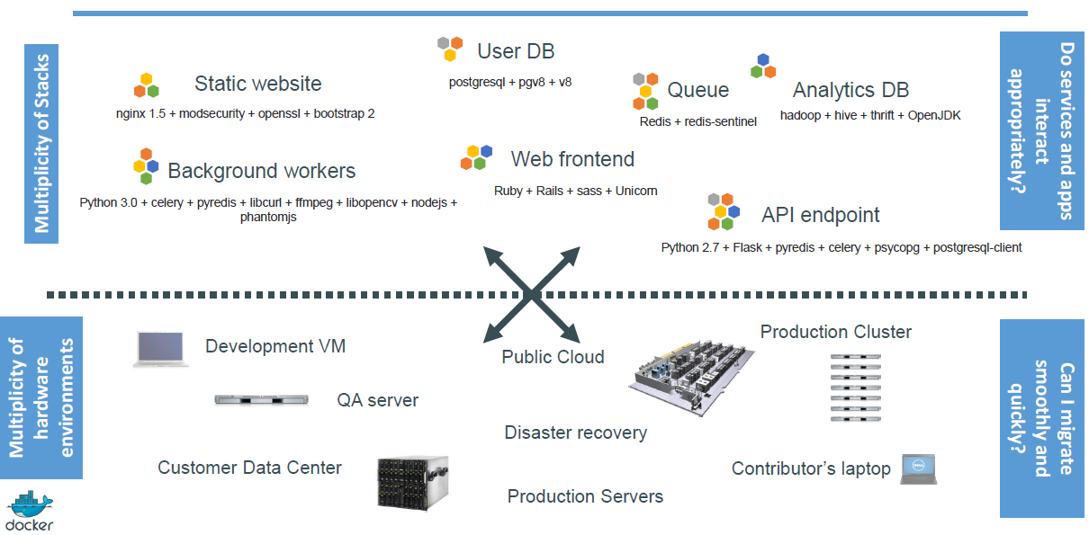
The Challenge

Slide 5
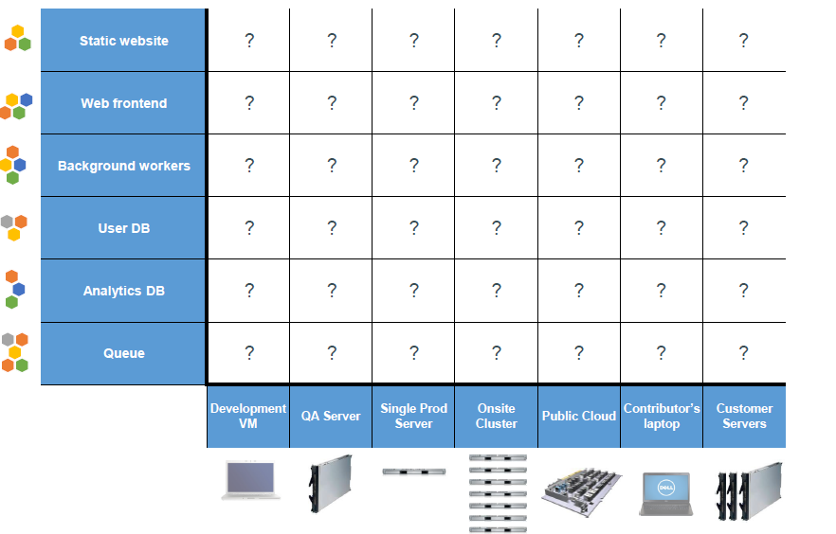
The Matrix From Hell

Slide 6
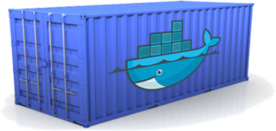

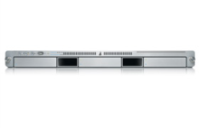
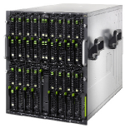
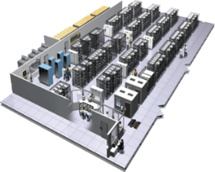
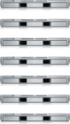

A Shipping Container for Code
Static website
User DB
Web frontend
Queue
Analytics DB
Do services and apps interact appropriately?
Multiplicity of Stacks
An engine that enables any payload to be encapsulated as a lightweight, portable, self-sufficient container…
…that can be manipulated using standard operations and run consistently on virtually any hardware platform
Multiplicity of hardware environments
Can I migrate smoothly and quickly
Development VM
Customer Data Center
Contributor’s laptop
QA server
Production Cluster
Public Cloud

Slide 7
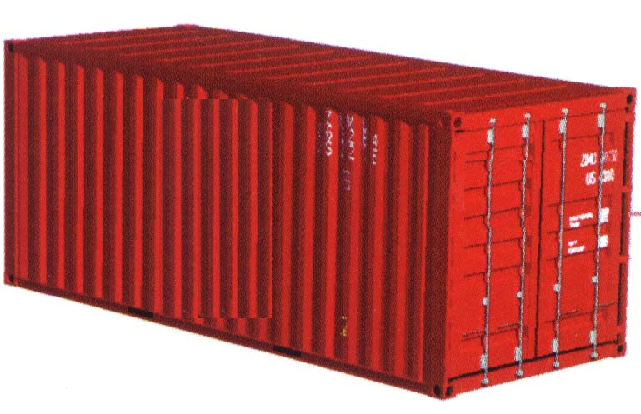
Dev vs Ops
Dev | Ops
Code Libraries Configuration Server runtime OS | Logging Remote access Network configuration Monitoring
Separation of concerns
A container separates and bridges the Dev and Ops in DevOps
Dev focuses on the application environment
Ops focuses on the deployment environment

Slide 8

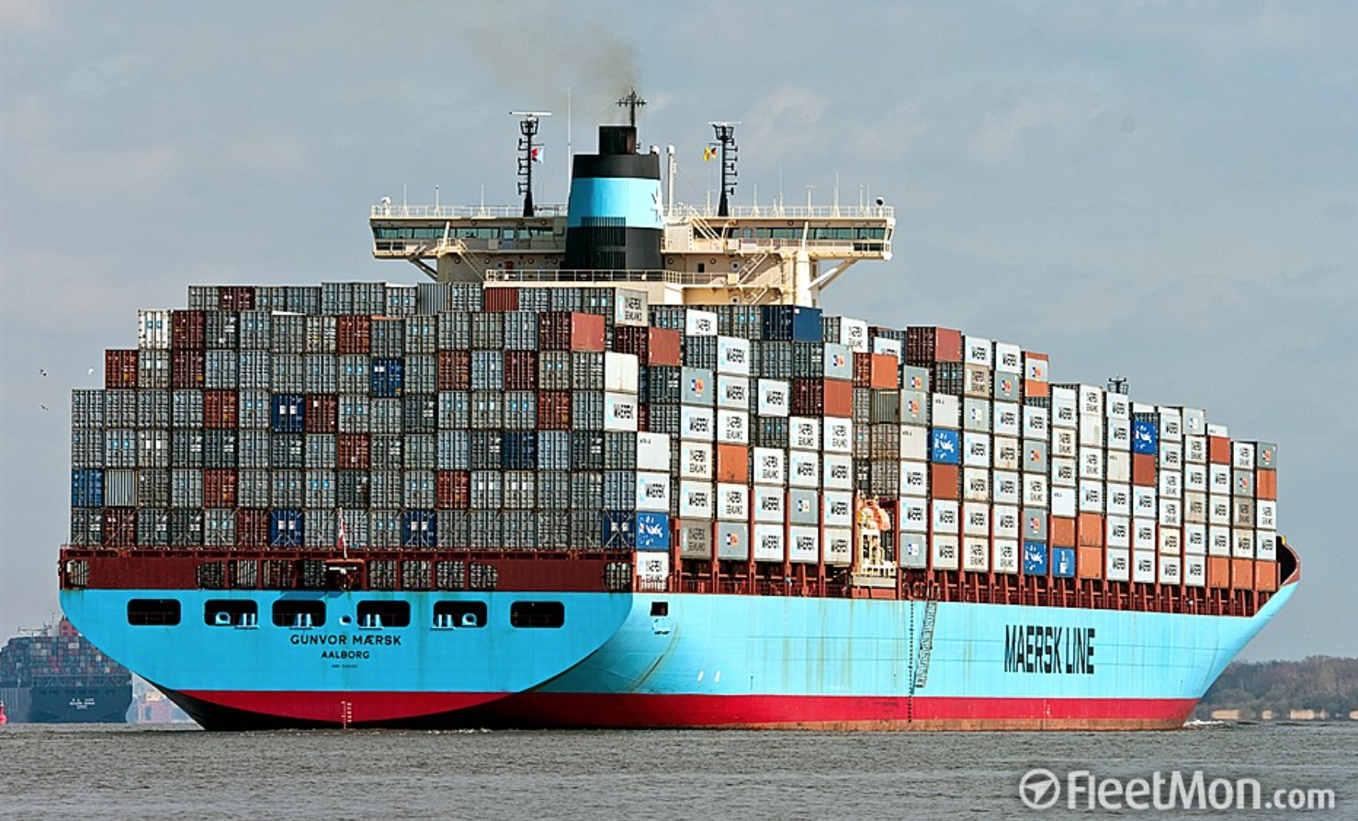
Everybody Loves Containers
A standard way to package an application and all its dependencies so that it can be moved between environments and run without changes
Containers work by isolating the differences between applications inside the container so that everything outside the container can be standardized

Slide 9
Container History Lesson
1982
2000
2005
2006
2007
2008
Today
Unix/chroot
BSD
OpenVZ
Parallels
AIX Wpars
IBM
FreeBSD jails/Solaris zones
Cgroups/Process Containers
IBM/Google
Linux Containers (LXC)

Slide 10
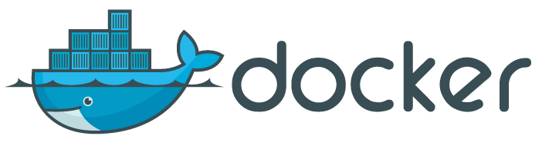

Multiple (De facto) Container Standards
Docker
The most common standard, made Linux containers usable by the masses
Rocket (rkt)
An emerging container standard from CoreOS, the company that developed etcd
Garden
The format Cloud Foundry builds using buildpacks
Open Container Initiative (OCI)
A Linux Foundation project developing a governed container standard

Slide 11
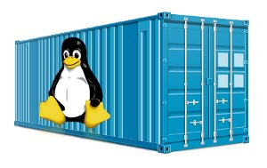
Advantages of Containers
Containers are portable
Any platform with a container engine can run containers
Containers are easy to manage
Container images are easy to share, download, and delete
Especially with Docker registries
Container instances are easy to create and delete
Each container instance is easy and fast to start and stop
Containers provide “just enough” isolation
More lightweight than virtual machines
Processes share the operating system kernel but are segregated
Containers use hardware more efficiently
Greater density than virtual machines
Especially Docker containers, which can share layers
Containers are immutable
Container images are versions
Containers cannot (should not) be patched

Slide 12
Docker Containers
Notes:
About Docker containers

Slide 13


Docker Adoption
Docker enables application development efficiency, making deployment more efficient, eliminating vendor ‘lock-in’ with true portability
Open software
Launched March 2013
2.0+ billion downloads of Docker images
Open contribution
2000+ contributors
#2 most popular project
185 community meet-up groups in 58 countries
Open design
Contributors include IBM, Red Hat, Google, Microsoft, VMware, AWS, Rackspace, and others
Open governance
Docker, the Open Container Initiative (OCI), and the Cloud Native Computing Foundation (CNCF) are jointly developing container standards

Slide 14


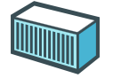
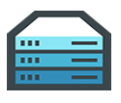









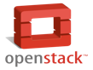




Docker Mission
Docker is an open platform for building distributed applications for developers and system administrators
Build
Ship
Run
Any App
Anywhere

Slide 15



Docker Components
Image
A read-only snapshot of a container stored in Docker Hub to be used as a template for building containers
Container
The standard unit in which the application service resides or transported
Docker Hub/Registry
Available in SaaS or Enterprise to deploy anywhere you choose
Stores, distributes, and shares container images
Docker Engine
A program that creates, ships, and runs application containers
Runs on any physical and virtual machine or server locally, in private or public cloud
Client communicates with Engine to execute commands
SaaS
Enterprise

Slide 16
VMs vs Containers
Containers are isolated,
but share OS and, where
appropriate, bins/libraries
…faster, less overhead
_{App}
_{A}
_{App}
_{A’}
_{App}
_{B}
_{Bins/}
_{Libs}
_{Bins/}
_{Libs}
_{Bins/}
_{Libs}
_{VM}
_{Guest}
_{OS}
_{Guest}
_{OS}
_{Guest}
_{OS}
_{Guest}
_{OS}
_{Guest}
_{OS}
App A
App A’
App B
App B’
App B’
App B’
Container
_{Hypervisor (Type 2)}
Bins/Libs
Bins/Libs
_{Host OS}
Host OS
_{Server}
Server

Slide 17
Docker Containers
Docker uses a copy-on-write (union) filesystem
New files (& edits) are only visible to current/above layers
CNTR1
CNTR2
CNTR3
CNTR4
Layer
app1
app2
app3
app4
Layer
tomcat
liberty
tomcat
Layer
Fedora
Ubuntu
Base OS / Kernel
Filesystem
Layers allow for reuse
More containers per host
Faster start-up/download time – base layers are "cached"
Images
Tarball of layers (each layer is a tarball)

Slide 18
Why Customers are Interested in Docker Containers
Containers are a critical foundation for hybrid apps
Ship more software
Accelerate development and CI/CD pipelines by eliminating headaches of setting up environments and dealing with differences between environments
On average, Docker users ship software 7X more frequently
Resource efficiency
Lightweight containers run on a single machine and share the same OS kernel while images are layered file systems sharing common files to make efficient use of RAM and disk and start instantly
App portability
Isolated containers package the application, dependencies and configurations together
These containers can then seamlessly move across environments and infrastructures

Slide 19
Conclusion

Slide 20
Conclusion
Why containers?
Docker containers

Slide 21
Resources
Docker tutorial
https://docs.docker.com/get-started/
The Evolution of Linux Containers and Their Future
https://dzone.com/articles/evolution-of-linux-containers-future
rkt
https://coreos.com/rkt
Cloud Foundry Garden container
https://docs.cloudfoundry.org/concepts/architecture/garden.html
Open Container Initiative (OCI)
https://www.opencontainers.org
Cloud Native Computing Foundation (CNCF)
https://www.cncf.io
Demystifying the Open Container Initiative (OCI) Specifications
https://blog.docker.com/2017/07/demystifying-open-container-initiative-oci-specifications

